Slide 1
Introduction to Clinical Pharmacology Chapter 1 General Principles of Pharmacology Paula Reeves BSN, RN

Slide 2
Learning Objectives
Define the term pharmacology
Compare and contrast the different names assigned to drugs and controlled substances
Distinguish between prescription drugs, nonprescription drugs, and controlled substances
Discuss drug development in the United States
Compare and contrast the various types of drug activity and reactions produced in the body
Identify factors that influence drug action
Explain drug tolerance, cumulative drug effect, and drug idiosyncrasy
Discuss the types of drug interactions that may be seen with drug administration
Examine the nursing implications associated with drug actions, interactions, and effects
Discuss the use of herbal medicines

Slide 3
Introductory Clinical Pharmacology Textbook User’s Guide
Beginning of Chapter
Objectives,
terms drug classes,
pharmacology in practice
Drug Information
Framework
alerts
lifespan
drug interaction tables
special features
Nursing Process and Drug Therapy
End of Chapter
Pharmacology in practice
key points,
summary drug tables
Chapter Review

Slide 4

Definition of Pharmacology
Pharmacology—The study of drugs and their action on living organisms.

Slide 5

Medications
Natural (e.g., digitalis)
Synthetic (e.g., mipomersen—Kynamro)

Slide 6
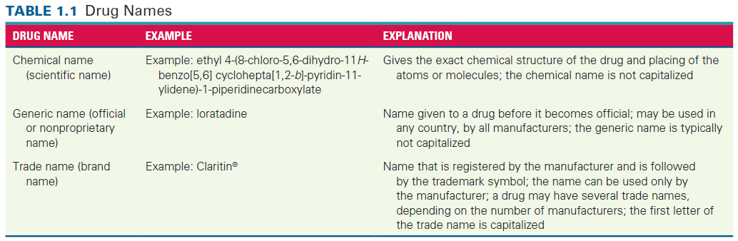
Naming Drugs
Each drug has three names
Chemical- exact chemical structure, not capitalized
Generic- Not capitalized, Worldwide, by all manufacturers.
Trade- Registered by manufacturer, trademark CAPTILIZED

Slide 7
Drug Classes and Categories
Drugs are organized into different classes and categories to help people better understand how they work in the body.
Examples of ways to classify drugs:
Cost and coverage
Legality
Chemical type or structure
Accessibility
Food and Drug Administration Categories
Prescription- See Fig. 1-1
Nonprescription (Over the counter OTC)
Controlled substances
See appendix A page 768
See nursing alert on page 5

Slide 8
Drug Development
Very long process 7 – 12 years
United States Food and Drug Administration (FDA) – is responsible for approving new drugs and monitoring drugs currently in use for adverse or toxic reactions
Divided into pre-FDA and FDA phases (see Fig 1-2, p.6 also on next slide)
MedWatch and Reporting Adverse Effects (Box 1.1, p. 7)

Slide 9
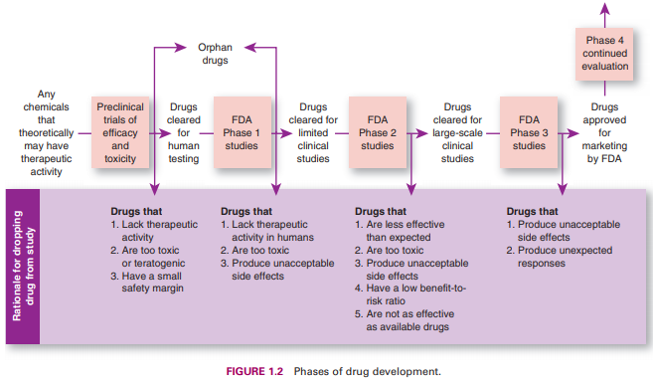
Drug Development in the United States
The Food and Drug Administration has the responsibility for approving new drugs and monitoring drugs currently in use in the United States for adverse or toxic reactions.

Slide 10
Accelerated Drug Programs
Accelerated approval/provisional approval
Diseases that are a threat to public health:
AIDS—considered for shorter IND approval process
COVID-19 vaccine—emergency use authorization granted for Pfizer-BioNTech, Moderna, and Johnson & Johnson/Janssen
Allows primary care providers to administer medications with positive results in early Phase 1 and 2 clinical trials
For example, with the COVID-19 vaccinations, the research and clinical trials were carried out in tandem rather than sequentially
Waiting until final approval not required: drug continues to prove beneficial—process of approval accelerated

Slide 11
How Drugs Work Within the Body #1
Once in the body, drugs act in certain ways of phases.
Oral drugs go through three phases:
Pharmaceutic phase
Pharmacokinetic phase
Pharmacodynamic phase
Liquid drugs or drugs given via injection only go through the pharmacokinetic and pharmacodynamic phases

Slide 12
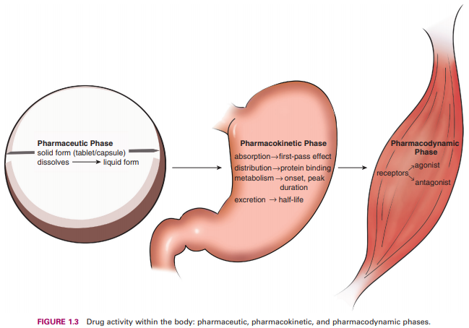
How Drugs Work Within the Body #2

Slide 13
Pharmaceutic Phase
Only refers to tablets and capsules
Drugs must be dissolved in order to be absorbed
Some tablets or capsules dissolve more slowly than others

Slide 14

Pharmacology in Practice Exercise #2
A client wants to know why their primary health care provider prescribes a liquid medication for an illness. How should the nurse best explain the process to the client?
Liquid medication is easier to swallow
Liquid medication is absorbed faster by the body system
Liquid medication delays absorption until the liquid reaches the small intestine
Liquid medication disintegrates into small pieces

Slide 15
Pharmacokinetics
Absorption
First-pass effect
Distribution
Metabolism
Excretion
Half-Life
Onset, Peak, Duration

Slide 16
Pharmacodynamic Phase
Deals with the drug’s action and effect in the body
Primary effect is desired, secondary effect may also be produced
May alter cellular function
May alter cellular environment

Slide 17
Alteration in Cell Environment
Physical changes
Osmotic pressure (Mannitol)
Lubrication (sunscreen)
Absorption (charcoal)
Alters the surface of the cell membrane
Chemical changes
Change in pH (antacids)

Slide 18
Receptor-Mediated Drug Action
Drug interacts with receptor; function of a cell alters; drug molecule joins with reactive site (receptor) on surface of cell
Agonist: binds with and stimulates receptor—therapeutic response
Antagonist: joins with but does not stimulate receptors; prevents drug response; competitive/noncompetitive
Effects of number of available receptor sites; potent drugs

Slide 19
Pharmacogenomics Phase
The study of peoples’ response to medications based on their individual genetic make-up
The Human Genome Project
Genetic make-up affects pharmacodynamics
Pharmacogenetics – the creation of individualized drug therapy that allows for the best choice and dose of drugs

Slide 20

Drug Use, Pregnancy, and Lactation
The use of any medication by expectant mothers carries the risk of causing birth defects
Teratogens
Appendix A p. 768 (A,B,C,D,X, and N- Transitioning to a newer system)
Many drugs are excreted through breast milk for breastfeeding mothers.
It is important for nurses to ask expectant and breastfeeding mothers about medications they take.
Risk summary, clinical data, and considerations for medications during pregnancy and lactation. (Drugs assigned an L1-L5 risk)
National Library of Medicine database LactMed

Slide 21
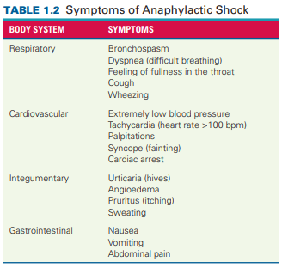
Drug Reactions
Adverse drug reaction is an undesirable drug effect (e.g., nausea)
Allergic drug reaction is a hypersensitive response of the immune system (e.g., rash, wheezing, anaphylactic shock)
Drug idiosyncrasy is any unusual or atypical reaction to a drug (e.g., a drug typically given for sleep like a hypnotic that instead causes wakefulness and excitement)

Slide 22
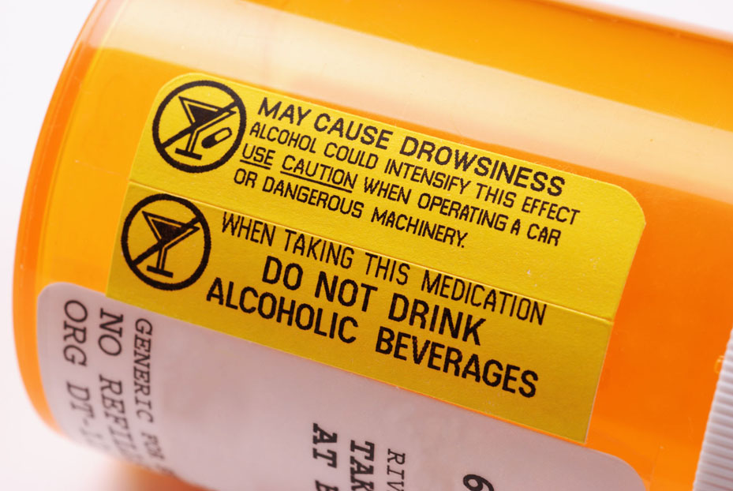
Drug Interactions
Additive—combined effect when two drugs are taken together (e.g., taking heparin with alcohol will increase bleeding)
Synergistic—effect of both drugs together is greater than each drug separately (e.g., taking a hypnotic with alcohol can increase the effect of the hypnotic and can be fatal)
Antagonistic—one interferes with the other drug or neutralizes the effects (e.g., protamine and heparin taken together will neutralize heparin causing blood clotting)
Drug–food—some foods can impair or enhance the drug absorption when a drug is taken orally

Slide 23
Nursing Implications
Know why the drug is being given
Know important facts before giving
Ex. Allergies, vital signs, lab work
Know what to observe after giving
USE YOUR NURSING JUDGEMENT!

Slide 24
Pharmacology in Practice Exercise #3
A client has a rash and pruritus (itching). As a nurse, you suspect an allergic reaction and immediately assess them for other more serious symptoms. What question would be most important to ask the client?
Are you having any difficulty breathing?
Have you noticed any blood in your stool?
Do you have a headache?
Are you having any difficulty with your vision?

Slide 25
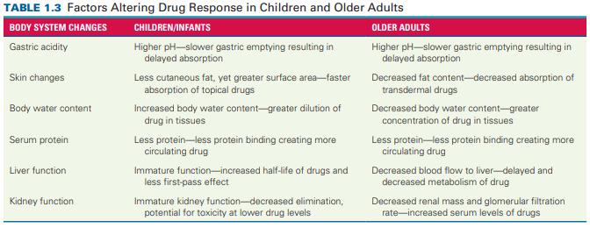
Factors Influencing Drug Response
When administering drugs, nurses must take into consideration certain factors that can influence drug response like age, weight, sex, disease, and route of administration.

Slide 26
Drug Tolerance and Cumulative Drug Effect
Drug tolerance occurs when there is a decreased response to a drug that requires an increase in dosage to help achieve the desired effect. Drug tolerance may develop with:
Opioids
Antianxiety drugs
Cumulative drug effect occurs when the body is unable to metabolize and excrete a normal dose of a drug before the next dose is given. Cumulative drug effect may develop in clients with:
Kidney disease
Liver disease

Slide 27

Nursing Implications With Drug Actions
Observe
Evaluate
Report
Record

Slide 28

Herbal Medicine, Health Care, and Nursing Responsibility
Many people from all over the world use herbs or complementary and alternative therapies to treat various disorders. Some herbal therapies are considered safe, while others can interact with other medications.
In the United States, the 1994 Dietary Supplement Health and Education Act defines herbs, vitamins, minerals, amino acids, and other natural substances as dietary supplements. These substances are not approved by the Food and Drug Administration
Nurses should ask about the use of natural substances (e.g., herbs, teas, vitamins, and other dietary supplements) when obtaining a drug history
Nurses can use the National Center for Complementary and Integrative Health to find research on the safety and efficacy of natural products, herbal remedies and dietary and food supplements

Slide 29
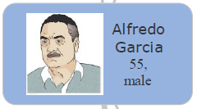
Pharmacology in Practice Exercise #1
Mr. Garcia has been prescribed metoprolol.
What are the three names for this drug?
What is metoprolol's category and class?

Slide 30
Turn and Talk—Case Study
Stanley Smith is a 70-year-old man. He has multiple medical conditions including hypertension, type 2 diabetes, and dyslipidemia. His current medications include aspirin 81 mg daily, Hyzaar 100/25 mg daily, Zocor 20 mg daily, and Glucophage XR 500 mg twice daily. He was admitted to the hospital today for treatment of community-acquired pneumonia. He is 70 inches tall and weighs 195 lb.
What factors does Mr. Smith have that might alter drug response?
Mr. Smith is given the anti-infective azithromycin 500 mg for one dose and then azithromycin 250 mg daily for the next 5 days and the cephalosporin ceftriaxone 1 g IV twice daily. After beginning the IV administration of ceftriaxone, Mr. Smith’s heart rate increases to 110 bpm, his blood pressure is 90/60 mm Hg, and he complains of difficulty breathing and itching. The nurse notices Mr. Smith has urticaria and angioedema and is sweating profusely. What should the nurse do?
What actions might the nurse need to take to a client experiencing anaphylactic shock?

